Slide 1
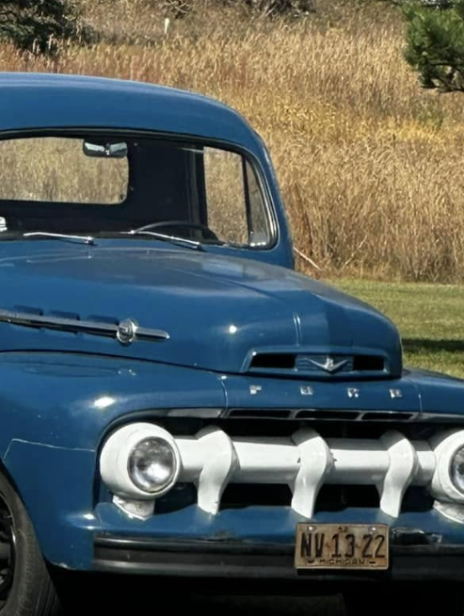
Who am I
Steve Schofield
Wife, three adult sons, two daughter-n-laws, three grandkids
Like old cars and trucks
Cybersecurity Analyst
Part-time computer teacher at MCC

Slide 2
Warm-Up Activity: Tech in Your Life
Think about the technology you use every day:
• What’s the FIRST device you used today?
• What device do you use the MOST?
• Which device would be the HARDEST to live without?

Slide 3
Warm-Up Instructions
Turn to a partner and discuss:
1. Name one device you use daily.
2. Why do you use it?
3. What would life be like without it?
4. Name one device your parents used to type letters before computers?
Be ready to share with the class!

Slide 4
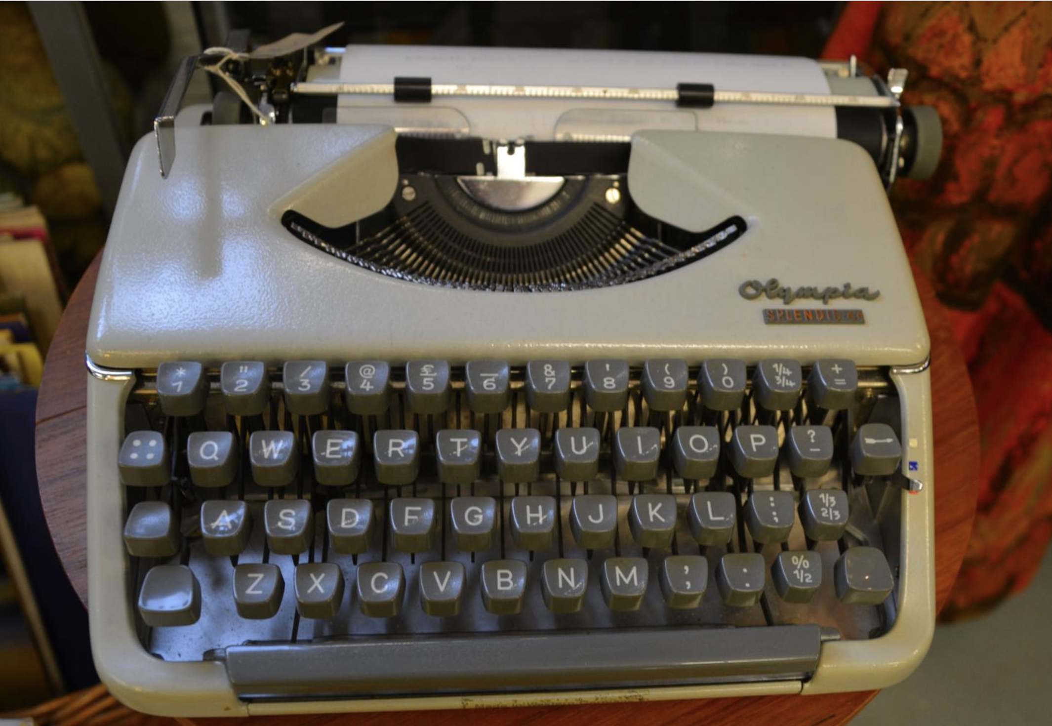
Warm-Up Instructions
Device is Typewriter

Slide 5
Welcome to: Guess the Device!
You'll see clues on one slide…
Try to guess the device before the reveal!
We start with everyday gadgets and move to basic IT gear.

Slide 6
How the Game Works
1. Each round shows three hints.
2. Try to guess the device.
3. Next slide reveals the device.
4. At the end, three cybersecurity questions!

Slide 7
Guess the Device!
Hints:
- Touchscreen device
- Runs mobile apps
- Always connected

Slide 8
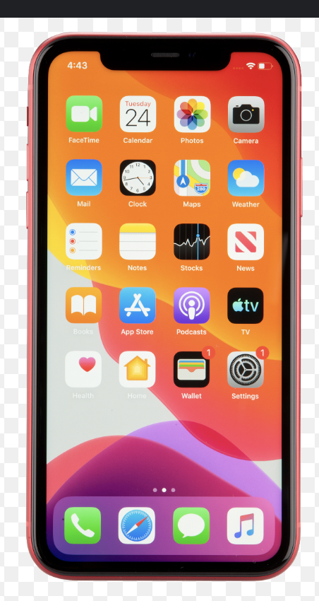
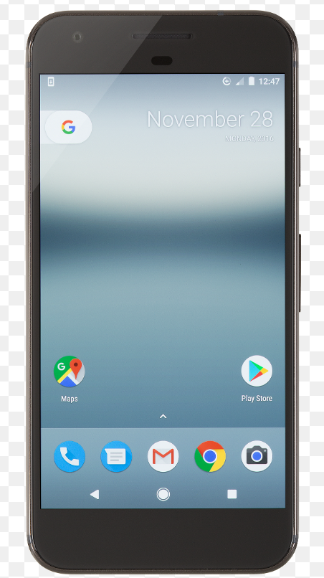
This device is: Smartphone

Slide 9
Guess the Device!
Hints:
- Portable touchscreen
- Used for videos and notes
- No physical keyboard

Slide 10
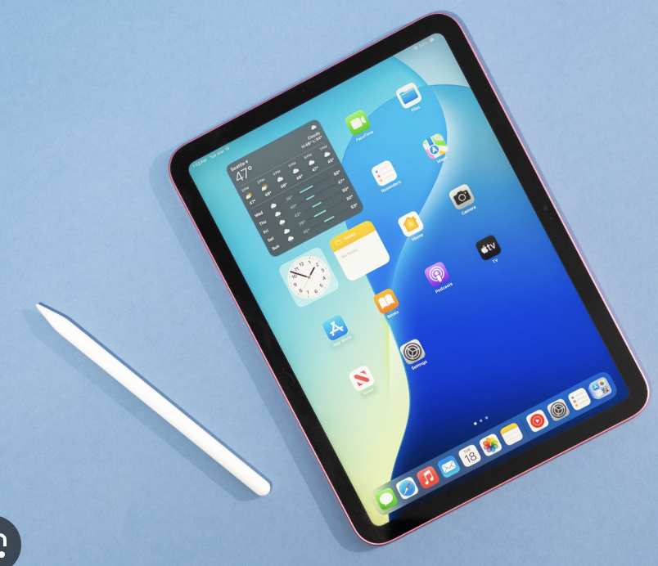
This device is: Tablet

Slide 11
Guess the Device!
Hints:
- Portable computer
- Built-in keyboard and screen
- Battery powered

Slide 12
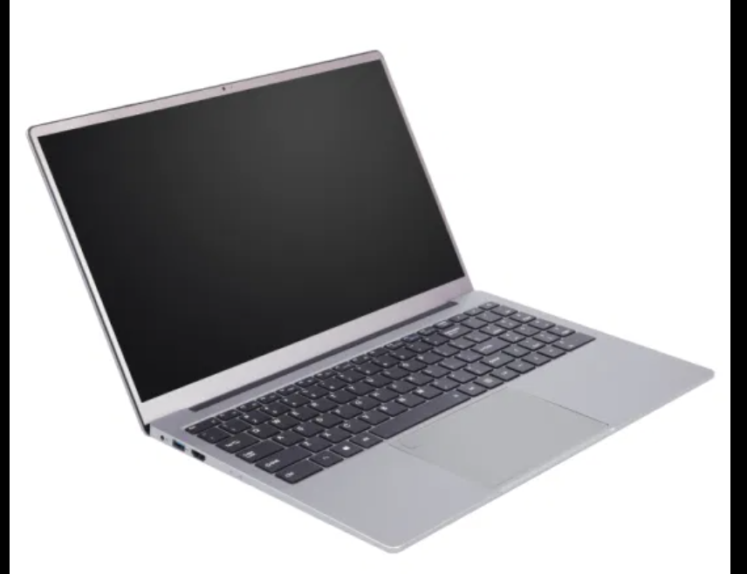
This device is: Laptop

Slide 13
Guess the Device!
Hints:
- Tower + monitor
- Uses mouse and keyboard
- Often upgradeable

Slide 14
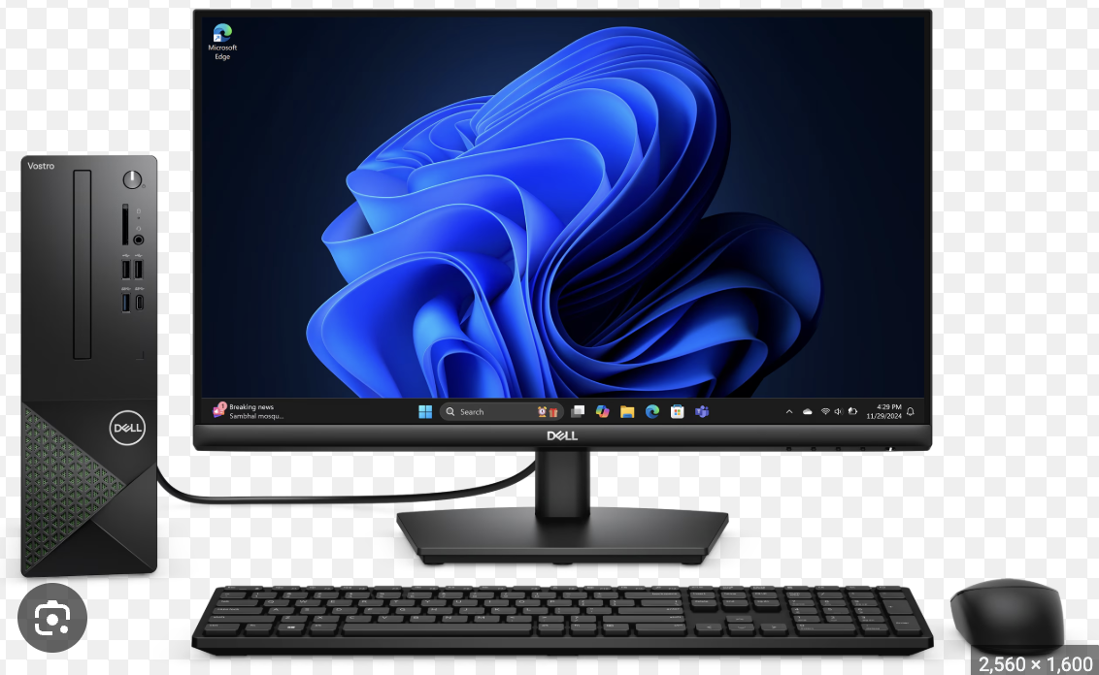
This device is: Desktop Computer

Slide 15
Guess the Device!
Hints:
- Worn on the wrist
- Tracks fitness
- Shows notifications

Slide 16
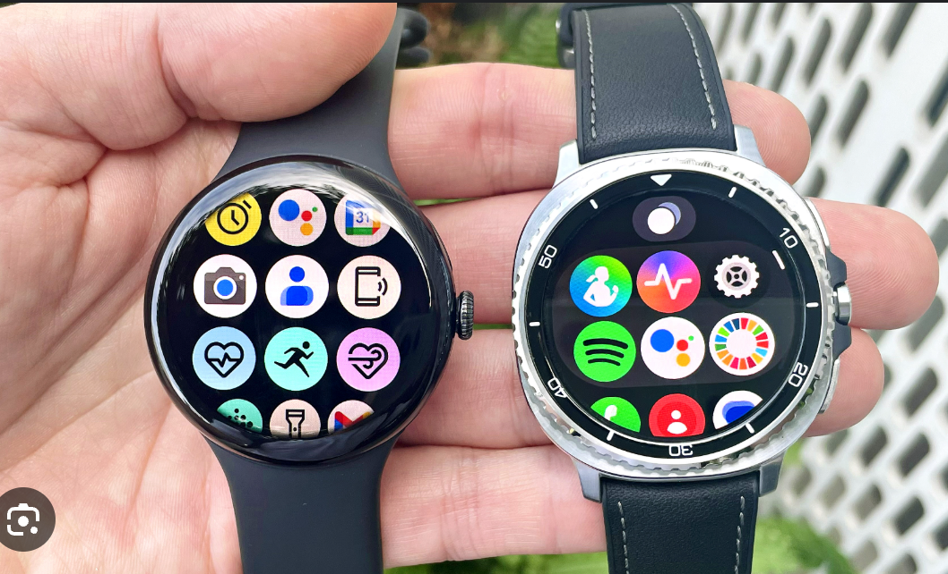
This device is: Smartwatch

Slide 17
Guess the Device!
Hints:
- Held with both hands
- Has joysticks and buttons
- Controls games

Slide 18
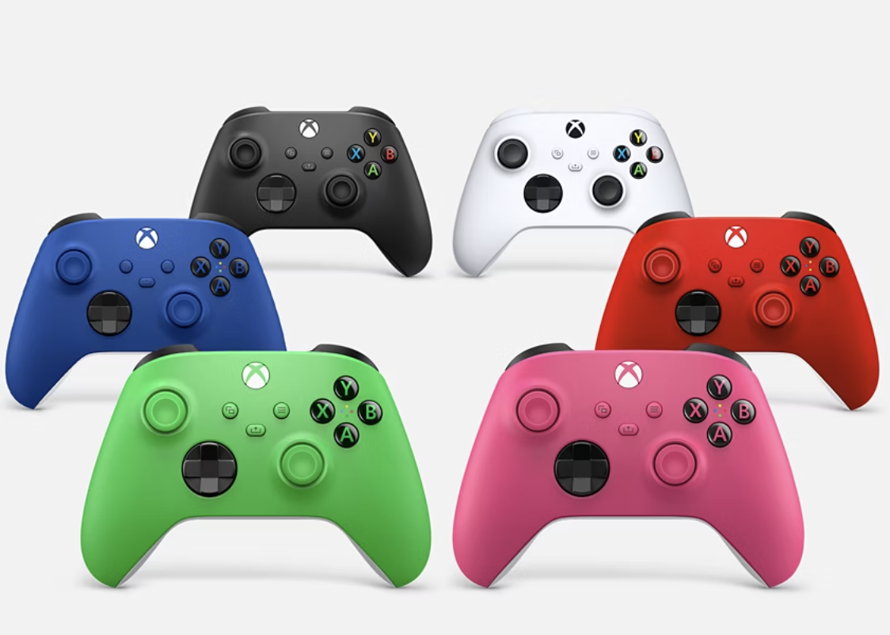
This device is: Gaming Controller

Slide 19
Guess the Device!
Hints:
- Connects to TV
- Plays games
- Uses controllers

Slide 20
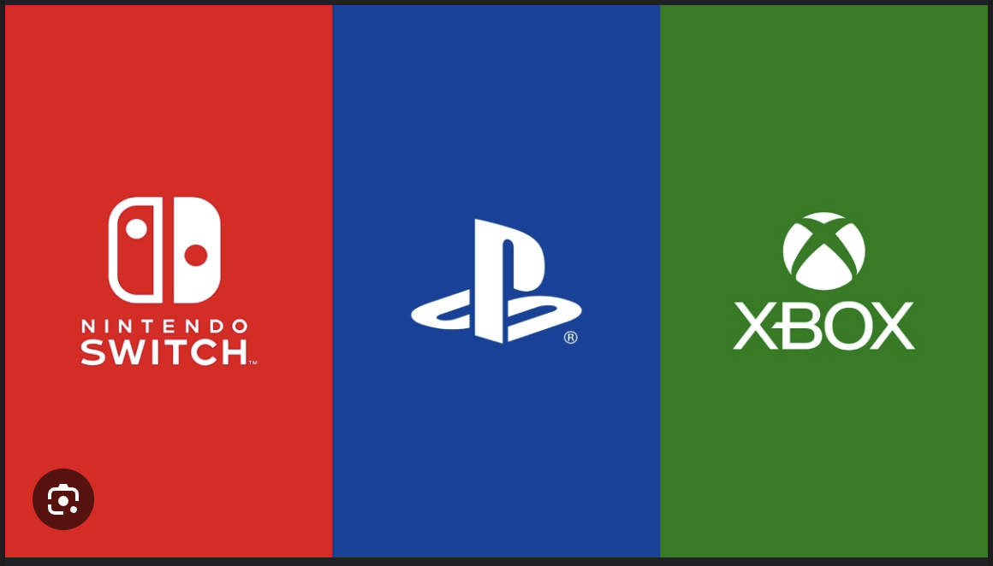
This device is: Game Console

Slide 21
Guess the Device!
Hints:
- Makes physical copies
- Uses ink or toner
- Often Wi-Fi connected

Slide 22
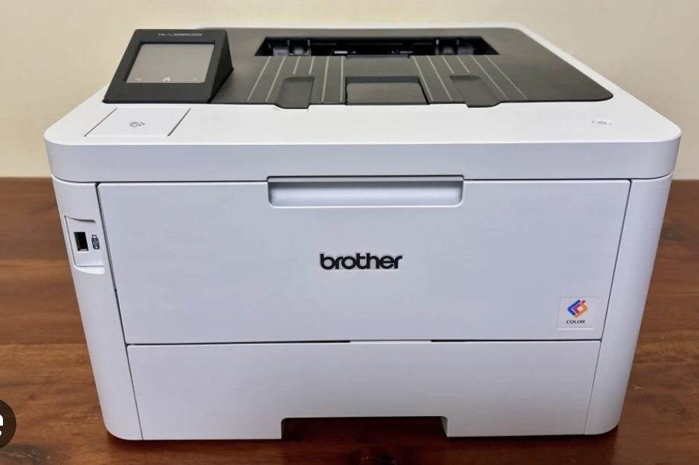
This device is: Printer

Slide 23
Guess the Device!
Hints:
- Creates home network
- Routes traffic
- Often has antennas
BONUS:
Provides DHCP (ip addresses)
Can provide WiFI (what is the Fi mean in WiFi)

Slide 24
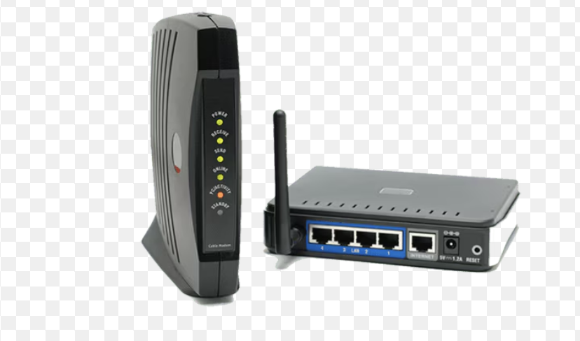
This device is: Router

Slide 25
Guess the Device!
Hints:
- Connects home to ISP
- Converts signals
- Near cable jack

Slide 26
This device is: Modem

Slide 27
Cybersecurity Question #1
What is Two-Factor Authentication (2FA)?
A) A second password you reuse everywhere
B) A backup email address
C) A second step like a code or device to prove it's really you

Slide 28
Cybersecurity Question #2
What should you do with a spam or phishing text?
Do you know what Phishing is?
A) Click the link to see what it is
B) Reply STOP
C) Delete or report it

Slide 29
Cybersecurity Question #3
Which password is strongest?
A) dog123
B) Z@rdw0rd!
C) Hot Pizza For Dinner&

Slide 30
Troubleshooting
What is one thing all devices have in common when not working?
What do you try to fix it?

